Slide 2
Getting Started in Dynamic Digital Signage
It’s a maze
out there…
Notes:
The signage industry is a veritable maze of different types of signs that convey messages, directions, advertising, calls to action, or simply basic information as to the status of something.
The methods used to convey all this information are almost too numerous to count but include signs printed on buildings, printed signs in a specific space, electronic signs, graphics wrapped around a car or truck, or even a message printed on a t-shirt and of course, most recently, dynamic digital signs.

Slide 3
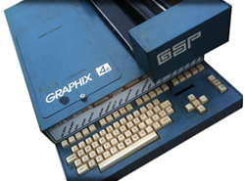
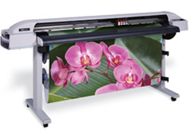
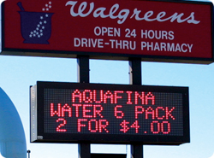
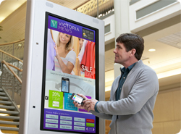
Evolution of the Sign Industry
Gerber Scientific Products introduces the Gerber 4A Vinyl Cutter
Encad and 3M introduce the Piezo Printer in to the Sign Industry
Many companies introduce LED’s in to the Sign Industry
Dynamic Digital Signage is introduced in to the Sign Industry

Slide 4
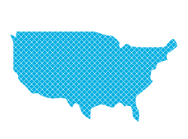
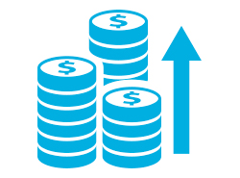
Market Growth of Static Signage Industry
$49.5
Billion
35,000+
Sign Shops in USA
Notes:
It is estimated that the overall static sign industry is approximately $49.5 billion with the US market being number one at over 50% of the total.
The best estimate we can find in terms of the number of sign shops in the USA is just over 35,000.

Slide 5
Market Growth of Dynamic Digital Signage
+23% in 2013
over $7 Billion in sales
Over $16 Billion
in sales in the next four years!
Notes:
The Dynamic digital signage market grew at over 23% in 2013, according to industry experts.
That growth meant over $7 Billion in sales in 2013.
The market is set to reach over $16 Billion in sales in the next four years!

Slide 6
What you will always sell in DDS
Displays
Mounts
Media Players
Software
Cables and Connectors

Slide 7
What you should also sell in DDS
Design and Installation
Content Creation
Software Updates
Service and Maintenance
Notes:
The obvious things you will always sell in dynamic digital signage are the hardware and software items mentioned earlier but the real profits, and in some case recurring revenues to be earned, are in the following areas.

Slide 8
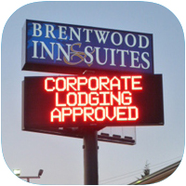
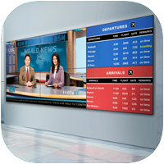
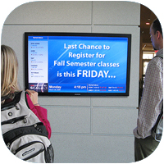
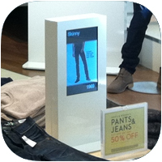
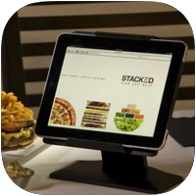
Types of Dynamic Digital Signs
Large LED – EMC Displays
Video Walls
Large Flat Panel Displays (LFD)
Small Flat Panel Displays (SFD)
Mobile Devices – Small Tablets

Slide 9
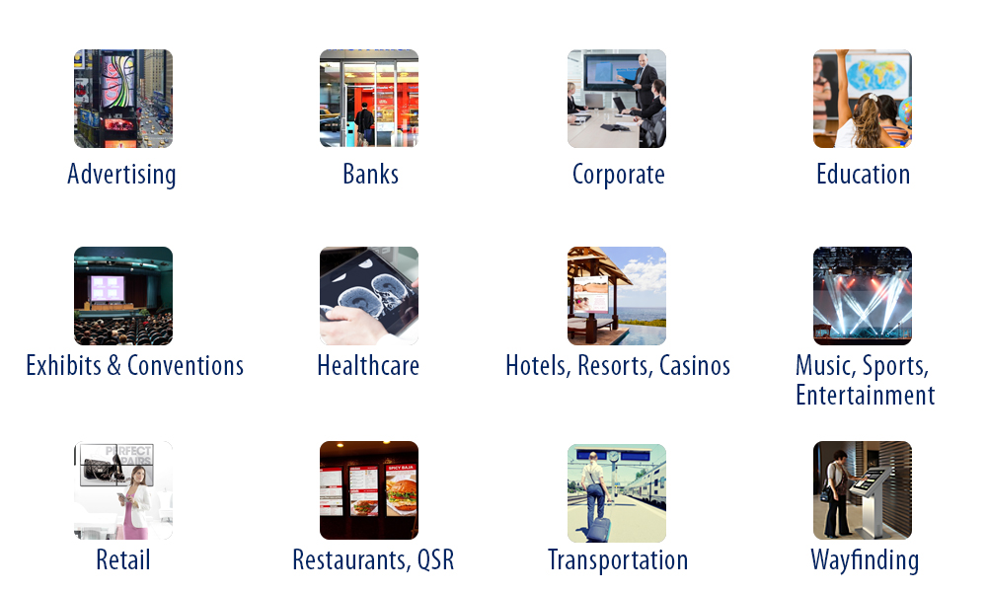
Applications for Dynamic Digital Signage
Notes:
Advertising
Banks
Corporate
Education
Exhibits & Conventions
Healthcare
Hotels, Resorts, Casinos
Music, Sports, Entertainment
Retail
Restaurants, QSR
Transportation
Wayfinding

Slide 10
Business Trends in Dynamic Digital Signs
Clarifying ROI vs ROO
Return on Investment:
When the money spent on a certain project gets a Return on the Investment dollars spent for that project
Examples: Menu Boards, Advertising Boards, Banks, etc.
Return On Objective:
When the money spent on a certain project gets a Return on the Objective on the investment dollars spent for that project
Examples: Way Finding Boards, Education, Transportation, etc.
Notes:
Return on Investment:
When the money spent on a certain project gets a Return on the Investment dollars spent for that project
Examples: Menu Boards, Advertising Boards, Banks, etc.
Return On Objective:
When the money spent on a certain project gets a Return on the Objective on the investment dollars spent for that project
Examples: Way Finding Boards, Education, Transportation, etc.

Slide 11
Content Trends in Dynamic Digital Signage
Social Media
NFC – Near Field Communications
QR Codes
Notes:
Social Media
NFC – Near Field Communications
QR Codes

Slide 12
Display Design Trends in DDS
Displays are designed for service and maximum up time.
Most Displays run 24/7
Displays have longer warranty periods and on-site
service contracts
Displays can be upgraded.
Displays are available in sizes over 100 inches
Displays are lighter with many key features built inside
the displays
Notes:
Displays are designed for service and maximum up time. Most Displays run 24/7.
Displays have longer warranty periods and on-site service contracts.
Displays can be upgraded.
Displays are available in sizes over 100 inches
Displays are lighter with many key features built inside the displays.

Slide 13
Software Trends in DDS
The Cloud
Subscription Based Software driven with templates from a remote
hosted server
SaaS or Bundled
Embedded Software inside a display or Bundled software from the
display manufacturer
Specific Industry Packages
Such as QSR, Banks, Way Finding, Touch, etc.
Notes:
The Cloud
Subscription Based Software driven with templates from a remote
hosted server
SaaS or Bundled
Embedded Software inside a display or Bundled software from the
display manufacturer
Specific Industry Packages
Such as QSR, Banks, Way Finding, Touch, etc.

Slide 14
Hardware Trends in DDS
Thin Bezel
Some less than 1” thick
High-brightness LCD
Some as bright as 2500 nits
24/7 Operation
Built-in Processors
Video Walls
Notes:
Thin bezel – Some less than 1” thick.
High brightness LCD – Some as bright as 2500 nits.
24/7 operation
Built in processors
Video Walls

Slide 15
Connectivity Trends in DDS
Wired
Wireless
Cellular
USB
Notes:
Wired
Wireless
Cellular
USB

Slide 16
Operations Trends in DDS
Logistics and Risk Abatement
National Installation and Service
Facilities + IT + AV are converging into one
Notes:
Logistics and Risk Abatement
National Installation and Service
Facilities + IT + AV are converging into one

Slide 17
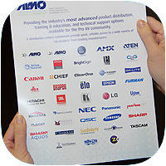
ALMO Pro A/V Solutions for DDS
ALMO Line Card
Strategic Collection of Partners
ALMO BDM’s
Specialized Experts here to assist you
ALMO Sales Force
Industry Trained Professionals
ALMO E4 Tour
Product Expo & Training Events
Notes:
ALMO Line Card – Under 40 Strategically selected Partners to provide you everything you will need.
ALMO Sales Force – Trained Professional Sales people calling on you in your shops.
ALMO BDM’s (Business Development Managers) Trained and specializing in the Products that we offer you.
ALMO E4 Tour – Training events held all around the US for your education and training on of all the products we offer

